Slide 1
EMCC Nov 19

Slide 2
Capillary Blood Glucose
Hypocount 5.2

Slide 3
ECG 1

Slide 4
ECG 2

Slide 5
ECG 3

Slide 6
Old ECG

Slide 7
ABG 1
pH 7.41
pC02 47
P02 71
Bicarb 30
BE 5
Sp02 94%
Lactate 0.67

Slide 8
ABG 2
pH 7.41
pC02 54
p 02 462
Bicarb 34
BE 10
Sp02 100%
Lactate 0.77

Slide 9
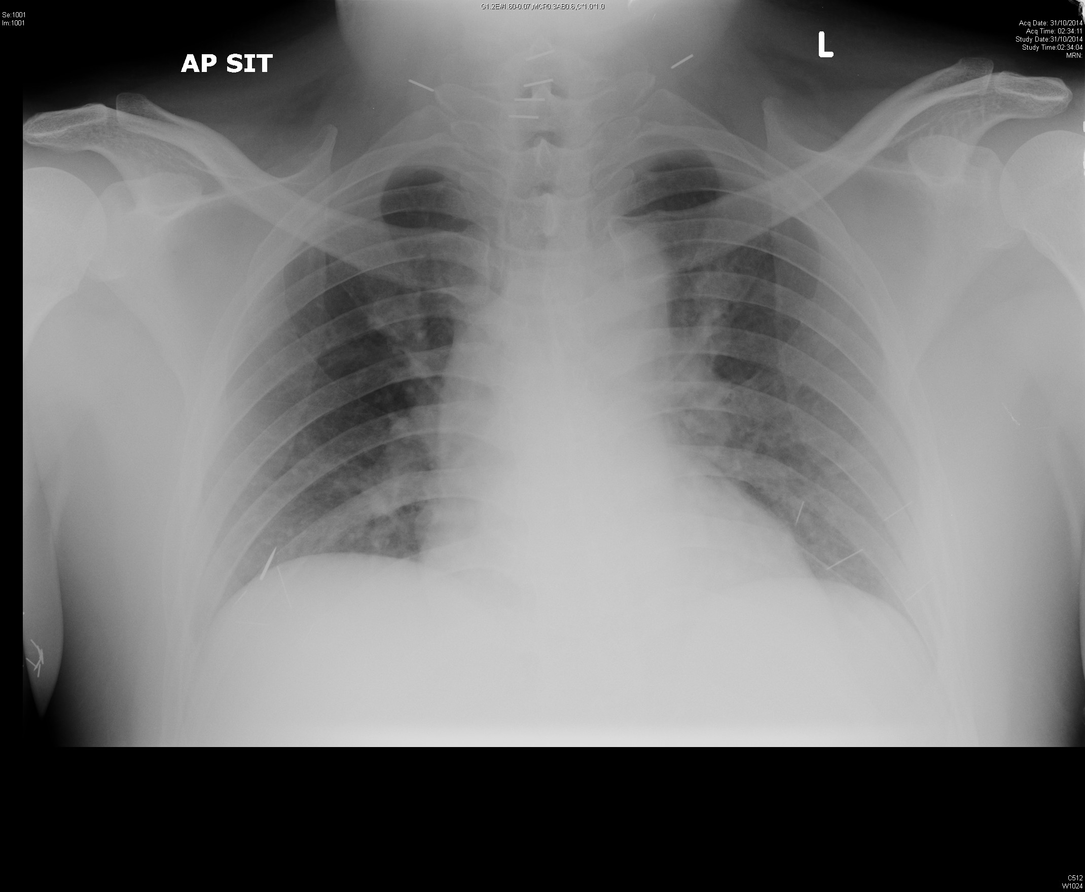
CXR 1

Slide 10
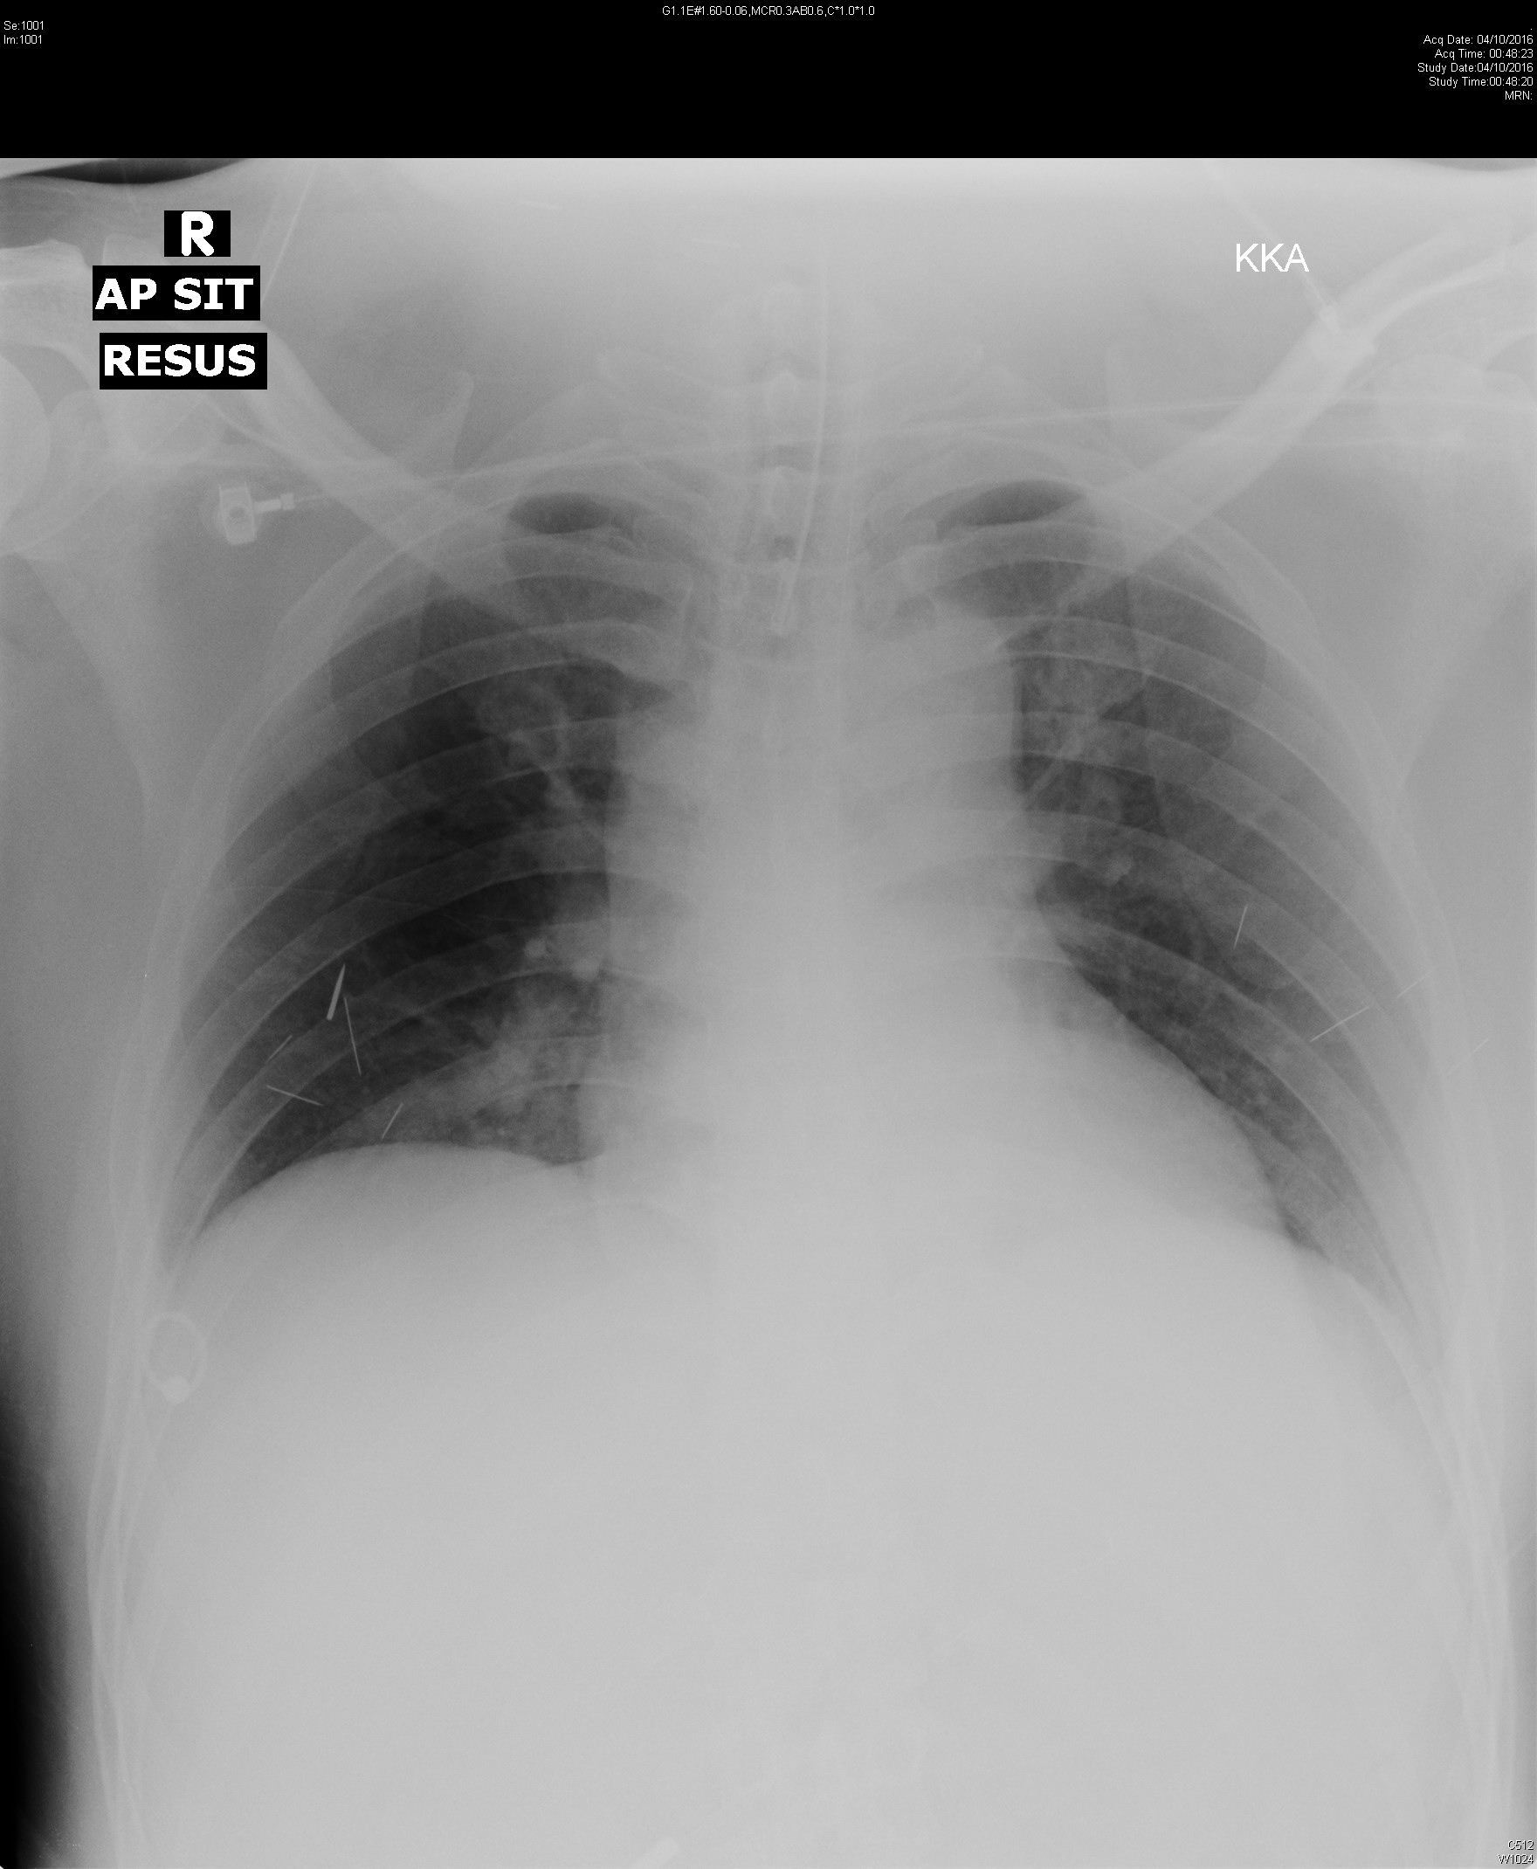
CXR 2

Slide 11
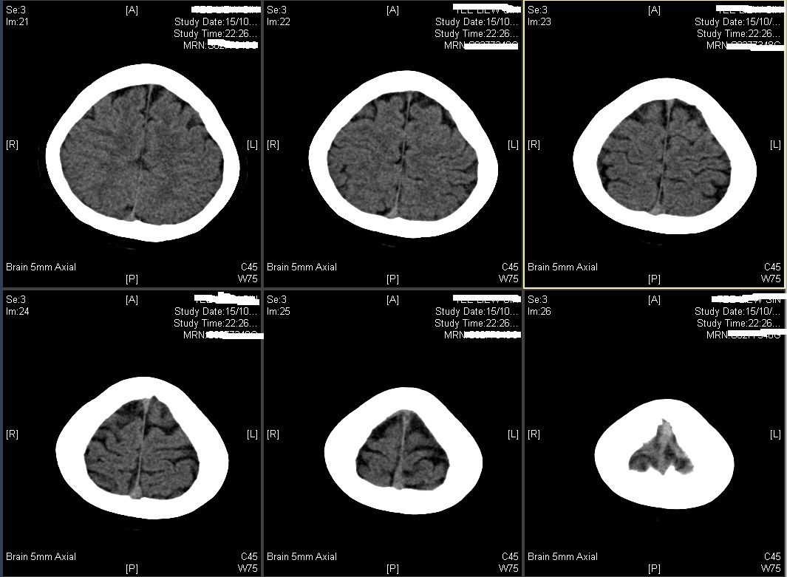
CT brain

Slide 12
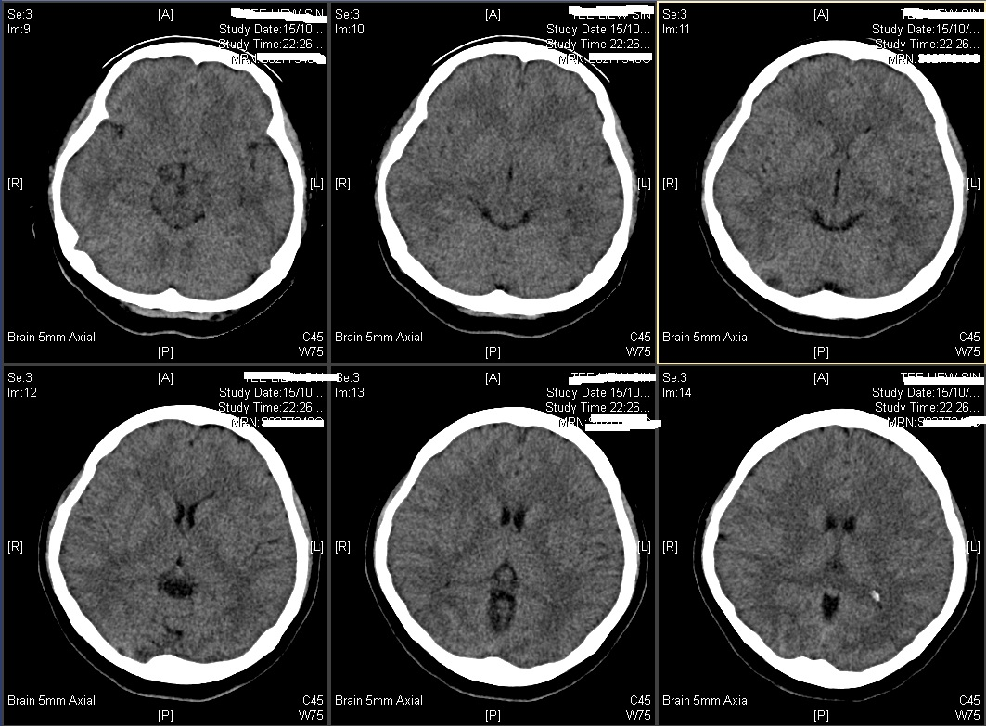
CT brain

Slide 13
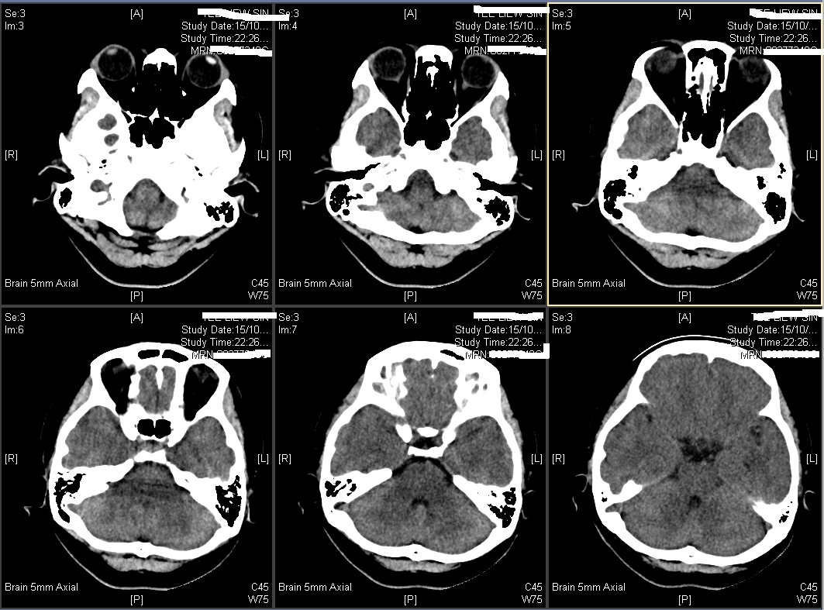
CT brain

